Slide 1


Mediator

Slide 2
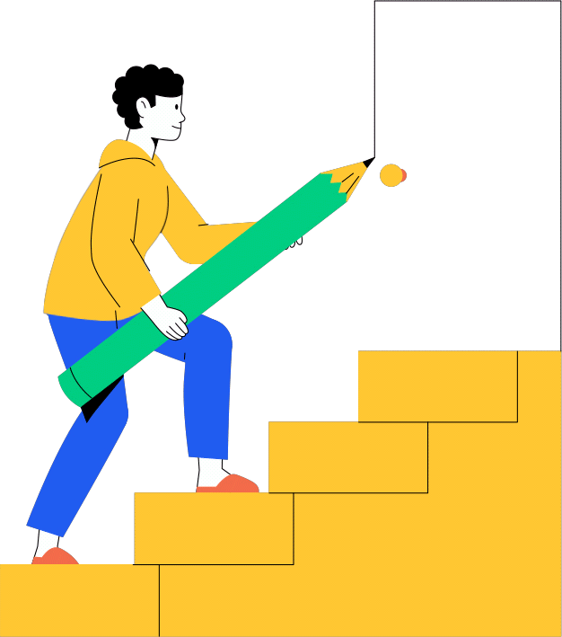
introduction

Slide 3

Brainstorming
To solve a problem facing people
We achieve our course objectives

Slide 4

Abdominal pain

Slide 5

The doctor forgot to ask
Or the patient gives an unclear answer

Slide 6

Mediator

Slide 7

Mediator
An intermediary between
the patient and the doctor
Record the patient's medical history
Medication conflicts

Slide 8

Pneumonia:

Slide 9

Search for
patient data

Slide 10

Conflicting medication

Slide 11

Non-contradictory medication

Slide 12


Diagnosis with
mediator

Slide 13
Collaboration
between Drs

Slide 14
ER Diagram

Slide 15
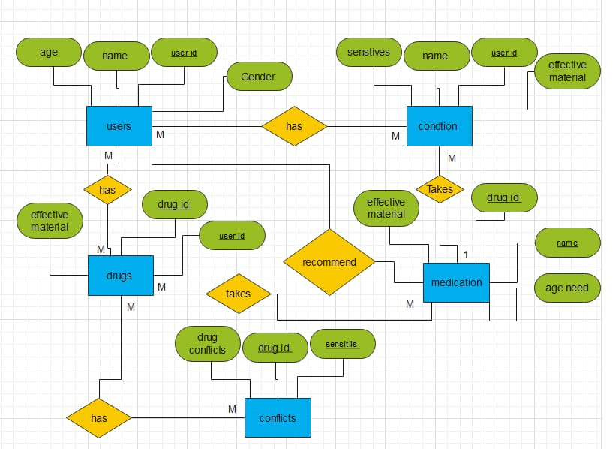

Slide 16
Database

Slide 17
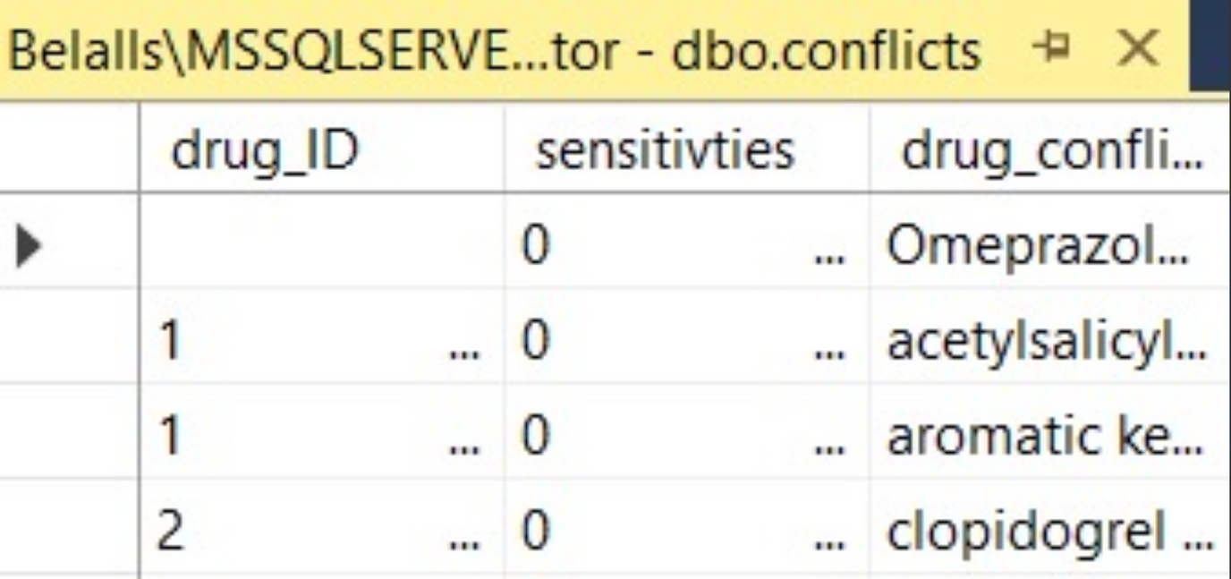
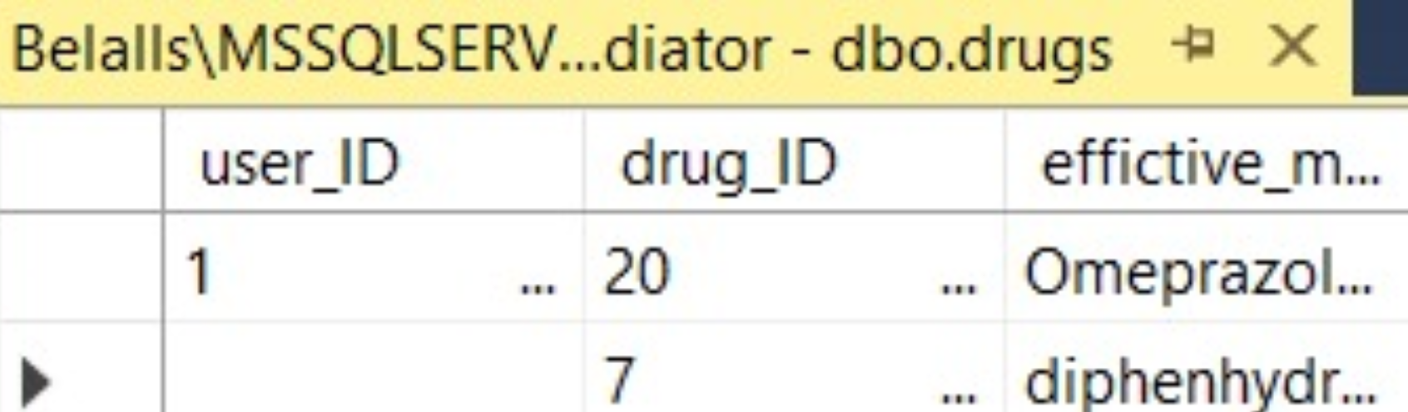

Slide 18
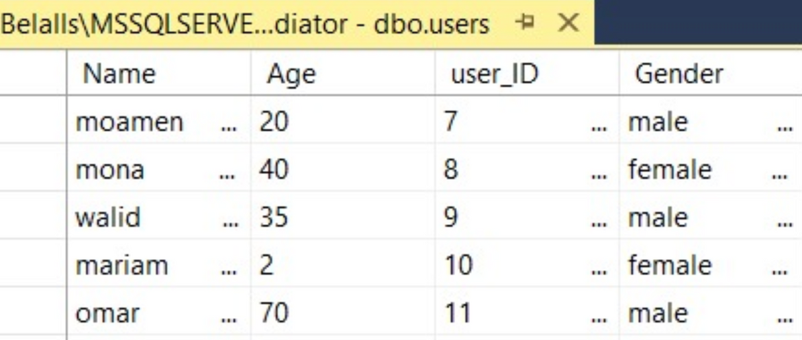
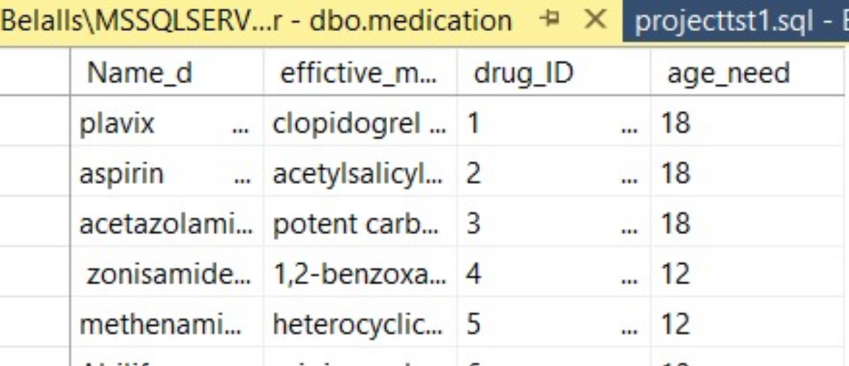
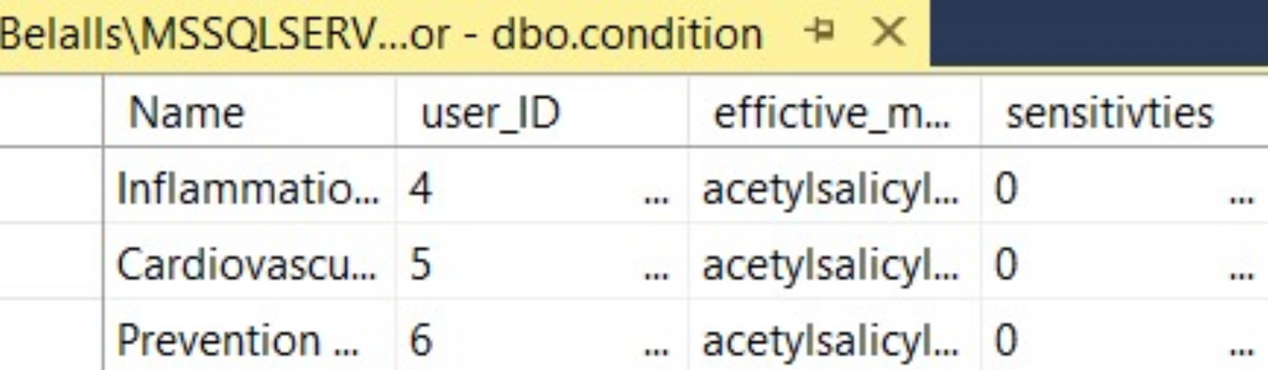

Slide 19
Examples
Examples

Slide 20
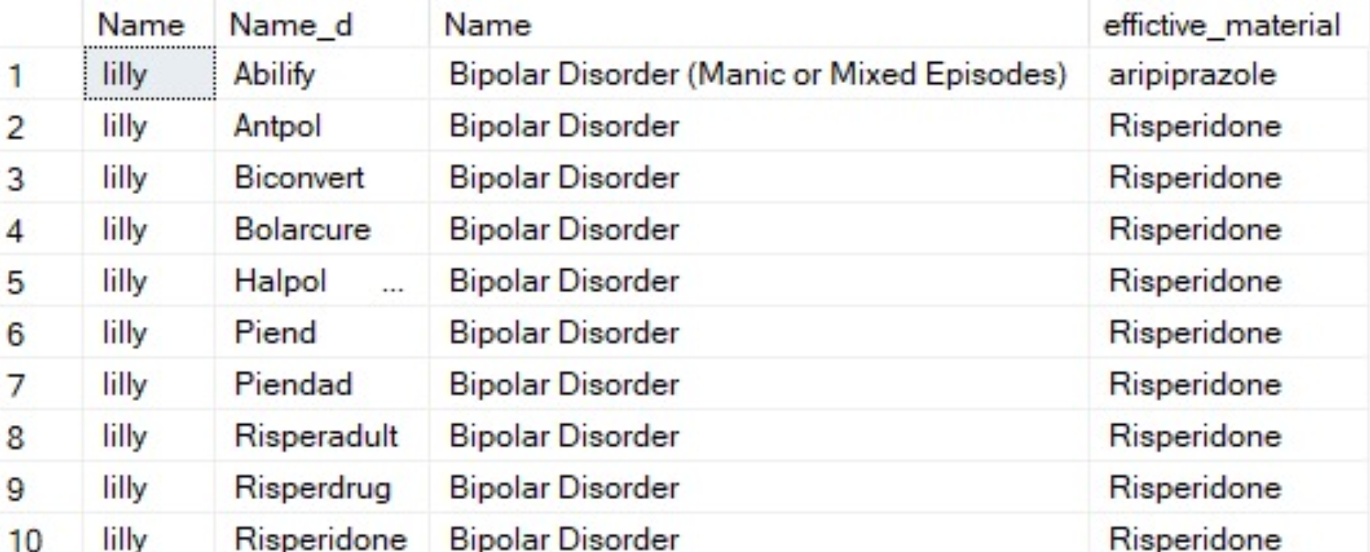

Slide 21
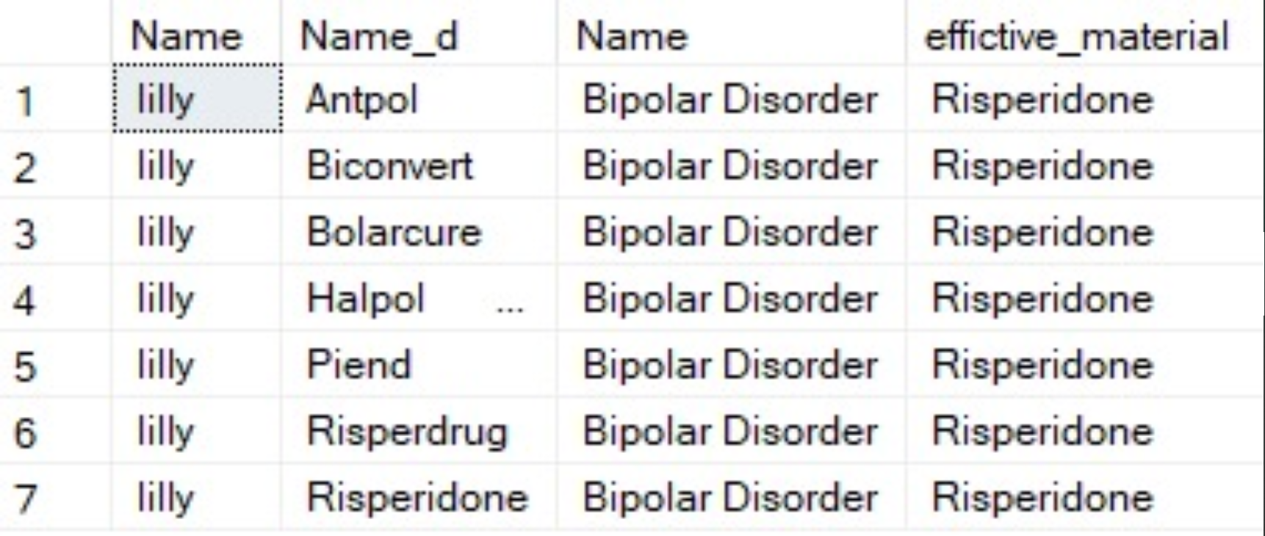

Slide 23
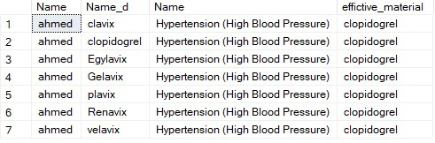

Slide 24
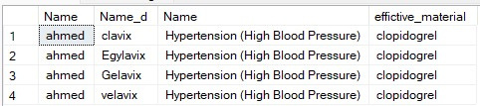

Slide 25
Results and next step

Slide 26
Next step
Results
Make a website
Increasing the data set
for medications
Database work on drug conflicts

Slide 27
Our goal
Giving a life opportunity to someone who could have taken a conflicting medication

Slide 28

Thanks

